Slide 1
Puritan / Witchcraft / 1952
Introduction to the Crucible

Slide 2
Puritan Lifestyle
http://www.history.com/topics/puritanism
Believed in God and the Devil very strongly
Family was very important
Always busy, never idle
Church was part of the law, they had to attend

Slide 3
Find Your Own Article
Search the internet for an article about your topic (Puritans, witchcraft in Salem, or what was going on in the world in 1952)
Find an article that is credible and has relevance to your topic
Print out article and read it. Annotate your article and make sure you understand it
Fill out worksheet and be prepared to present your article NEXT class period

Slide 4
New England Colonies
Separatists
Puritans were separatists who wanted to reform the Church of England.
Persecuted in England; Fled to the Netherlands. There was religious freedom there but few jobs.

Slide 5
Puritans
Came to America in 1629 to practice religion. Unhappy with the Church of England. 1630s – the Great Migration (15,000 +)
John Winthrop governed the Massachusetts Bay colony, but later white, male property owners had a voice/could vote.
Practice their religion freely NOT freedom of religion

Slide 6
New England Way
Work together for the good of the whole – a commonwealth
Congregation (basic unit), meetinghouse (center of town)
No separation of church and state
It was law to attend church. Services were long, boring, solemn, required.
Hard work and education emphasized; no dancing/games.

Slide 7
Salem Witchcraft Trials (1692)
Puritans very rigid; everything centered around the church. Young Puritans – less religious. Minister Cotton Mather explained this was due to “evil influences.”
Young girls were “bewitched” by various members of the community.
A witch hunt ensues – 100+ arrested/20 put to death
Why? Changes in society needed to be explained. What is a scapegoat?

Slide 8
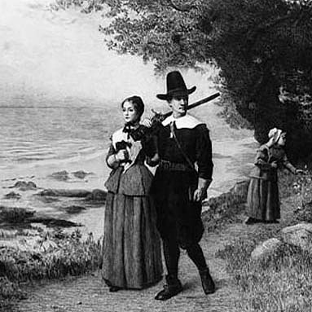
Dress
Girls: long skirt, below the knee, long sleeve shirt, pull hair back in a bun, NO make-up, perfume, jewelry
Boys: Slacks, long sleeve button up shirt, tuck in shirt, part hair in center, no sneakers
Both: Dark, plain colors, simple, no patterns

Slide 9
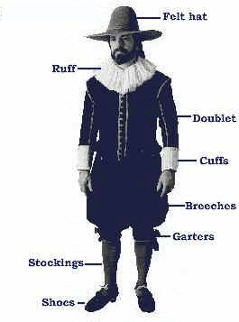
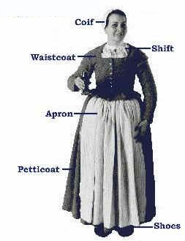

Slide 10
Arthur Asher Miller
1915-2005, Born in Harlem, New York
Went to University of Michigan
First success was Death of a Salesman
Married 4 times ( Mary Slattery, Marilyn Monroe, Inge Morath, Anges Barley)
1956- persecuted and called to testify against people at a communist writing meeting, he refused, convicted of contempt, later won an appeal

Slide 11
Joseph McCarthy
Republican U.S. Senator from Wisconsin
1952 Eisenhower first Republican president in 20 years
Face of the cold war
McCarthy anti-communist hearings in the 1950s
Anti- Communism: he charges people with communism, disloyalty, etc. Tried to expel from government positions, or publicly accused people
Censured (voted out of) his office in a 67 to 22 vote

Slide 12
About McCarthy
“Senator McCarthy’s zeal to uncover subversion and espionage led to disturbing excesses. His browbeating tactics destroyed careers of people who were not involved in the infiltration of our government. His freewheeling style caused both the senate and the subcommittee to revise the rules governing future investigations, and prompted the courts to act to protect the Constitutional rights of witnesses at Congressional hearings… These hearings are a part of our national past that we can neither afford to forget nor permit to reoccur.”
Senators Susan Collins and Carl Levin

